Slide 1

AI RESUME SCORE CARD..
My Resume.
Name:
Mail:
Phone:
Your score: ---/100

Slide 2

Introduction
In the modern job market, recruiters receive hundreds of resumes for a single position, making manual evaluation inefficient.
An AI Resume Scorecard automates this task by matching resumes with job descriptions using Natural Language Processing (NLP).
This reduces bias, improves efficiency, and helps job seekers optimize their resumes.

Slide 3
Objective
The goal of this project is to create a Python-based tool that:
Extracts text from resumes in PDF, DOCX, or image format.
Accepts a job description as input.
Compares and evaluates the resume based on keyword matching.
Calculates a relevance score out of 100.
Provides qualitative feedback based on the score..
This helps users understand how well their resume fits a particular job and guides them in improving it.

Slide 4
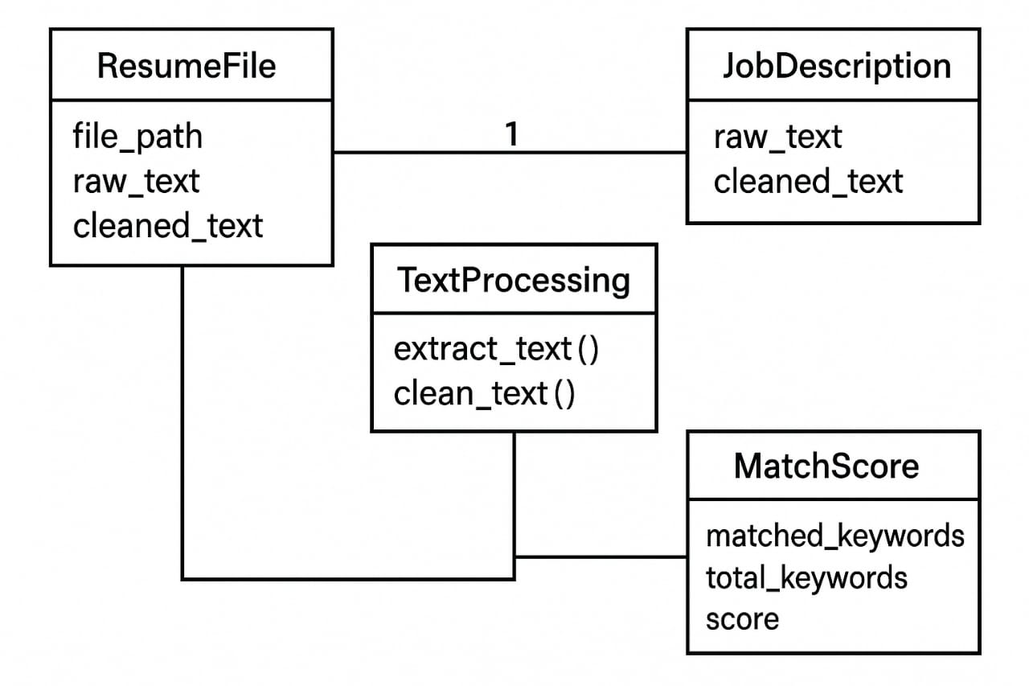
System Architecture…

Slide 5





Technologies Used…
Pdf plumber PDF text extraction | python-docx DOCX file handling | pytesseract, pdf2image, PIL OCR for image-based PDFs and images | NITK Natural language processing (tokenization) | Re, Os, Flask File handling, regex, and UI dialogs, Flask is used as backend frame work.

Slide 6
Features
✅ Multi-Format Support: Accepts PDF, DOCX, and images (JPG, PNG, etc.)
🔎 OCR Integration: Automatically detects and handles scanned PDFs using OCR.
🧠 Keyword-Based Matching: Uses simple set logic to match job description keywords.
📊 Resume Scoring: Scores range from 0 to 100, depending on keyword overlap.
💬 Feedback System: Provides insights based on match percentage.
🎯 Text Cleaning & Tokenization: Ensures clean and accurate comparisons.

Slide 7

Applications
Pre-screening tool for recruiters.
Resume optimization aid for job seekers.
Student placement and career counseling platforms.
Integration into job portals and HR software.

Slide 8
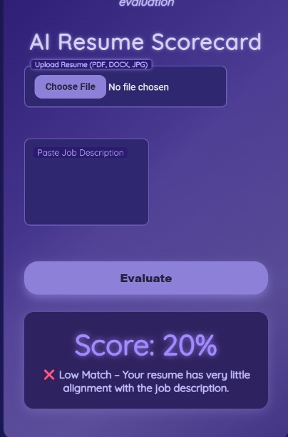
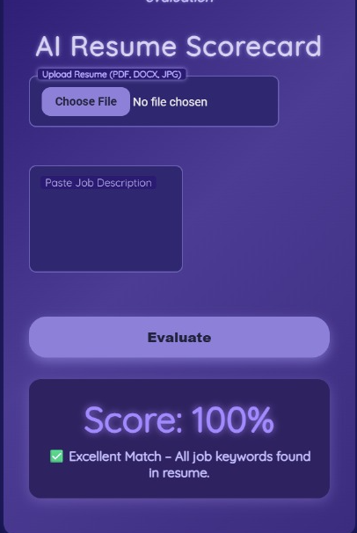
Output…

Slide 9
Conclusion
This AI Resume Scorecard project demonstrates how simple NLP techniques can be used to streamline the resume screening process. By combining multi-format text extraction, keyword analysis, and intelligent scoring, it empowers users to tailor their resumes to job descriptions effectively. The tool is flexible, accurate, and easy to use for both professionals and students

Slide 10
Future Enhancements
Integration with a full GUI or web app using Flask
Advanced NLP with named entity recognition (NER) and part-of-speech tagging
Machine learning model to learn from recruiter preferences
Highlighting exact matched and missing keywords in the resume
Support for multiple resumes and batch processing

Slide 11
THANK YOU…

